Slide 1
Chemistry and Matter
Chemistry- The study of composition, structure, and properties of matter and changes they undergo.
Chemical – any substance that has a definite composition (in terms of atoms that compose it)
Branches
Organic Inorganic
Analytical Biochemical
Physical Nuclear
Scientific Roles
Basic Research
Applied Research
Technological Application

Slide 2
Scientific Method
What is it???
Logical, systematic approach to solve a problem
Four Steps:
1. Observe - collect data (qualitative – description /
quantitative – numerical)
2. Hypothesize – proposed explanation that is
testable
3. Test/Experiment – is the hypothesis correct?
4. Theorize – generalization that explains fact
or phenomenon

Slide 3
Weight vs. Mass Are they the Same?
Weight – measure of the earth’s gravitational attraction for matter
Mass – measure of the quantity of “matter”
By definition they are different…
How would your weight change on the moon? On a mountain top? On the Sea floor?
Weight
Mass
Matter 1. Occupies space and has mass
2. Displays inertia (resistance to change in motion)
Law of Conservation of Matter(mass) – mass cannot be created nor destroyed

Slide 4
Matter
Pure Substances
Mixtures
uniform and definite composition
physical blend of two or more components
Elements
1 type of atom
Compounds
2 or more types of atoms bonded
Homogeneous Mixture
Heterogeneous Mixture
(Solution)
1 phase
2 or more phases
Na, Ag, H₂, O₂
Bonded together Just mixed up
Whole # ratios
Mixed up completely (uniform)
Mixed chunks you can see (not uniform)
NaCl, H₂SO₄, H₂O
Stainless steel, milk, salt water
Granite, concrete, sand in water

Slide 5
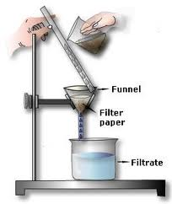
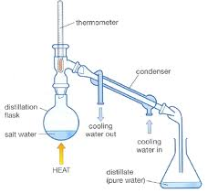
Separating a Mixture
Differences in Physical Properties can be used to separate a mixture. (solubility, BP)
Filtration - Distillation

Slide 6
SOLID | LIQUID | GAS
Has its own shape | Takes shape of container | Fills container
Highest density | Middle density | Lowest density
Not compressible | Not compressible | Compressible
Little movement | Some movement | Rapid movement

Slide 7
Periodic Table of Elements
Metals
Non - metals
(On this side of the blue staircase)
(On this side of the blue staircase)
18 Groups
(Vertical columns)
7 Periods
(Horizontal columns)
Metalloids
(Touch the blue staircase)
blue staircase

Slide 8
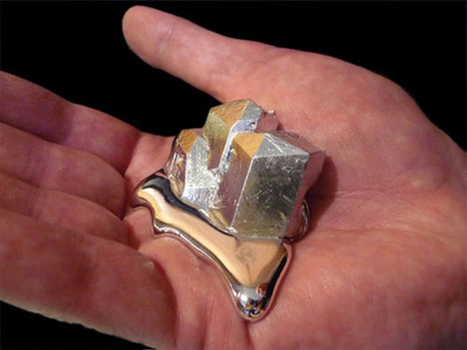
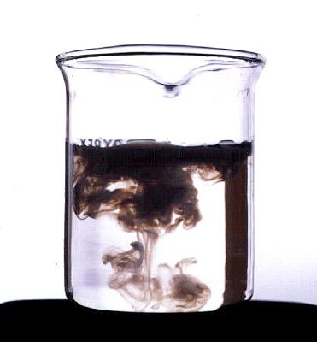
Physical Change vs. Chemical Change
Physical Change
does not change chemical character/composition of the substance
ex. Pounding…tearing into pieces, pulling, melting, boiling…
Chemical Change
produces a substance with new chemical properties
Ex. rxn with H₂O…rxn with acid or base…combustion
Indications of a Chemical Change:
1. Change in energy
Endothermic – energy is absorbed (feels cold)
Exothermic – energy is released (feels hot)
2. Production of gas
3. Change in color
4. Formation of a precipitate (solid)

Slide 9
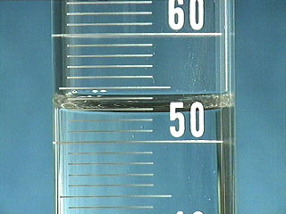
Properties of Matter
Chemical Property – relates to substance’s ability to undergo change that transforms it into a different substance (change in matter)
Physical Property – characteristic that can be observed without changing the identity of the substance (no change in matter)
Extensive – depends on the amount of a substance present (ex. Length, mass, volume, solubility)
Intensive – does not depend on the amount of a substance present (ex. Density, malleability, ductility, conductivity, color, melting point, boiling point

Slide 10
Lab Notebooks!
Take out lab notebook
Put your name, the block and my name on the front (in pen or sharpie)
Open to the front page and label at the very top “Table of Contents”
Label this page as page 1 (either top right or bottom right)

Slide 11
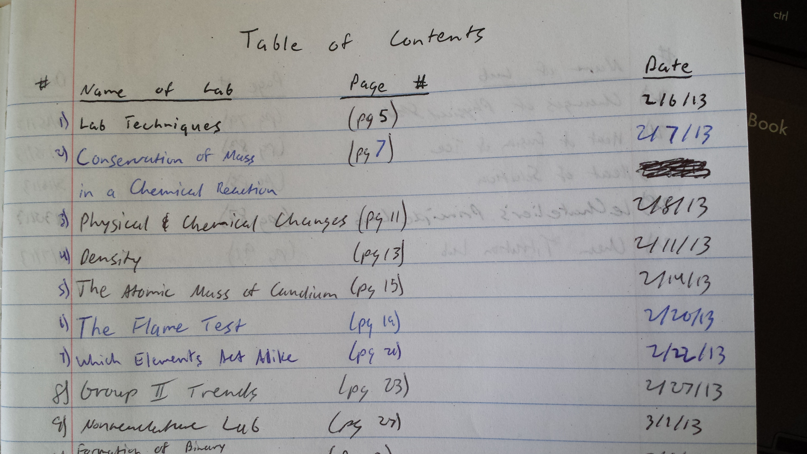
Table of Contents Example
Page #
*You need to include these 6 things!

Slide 12
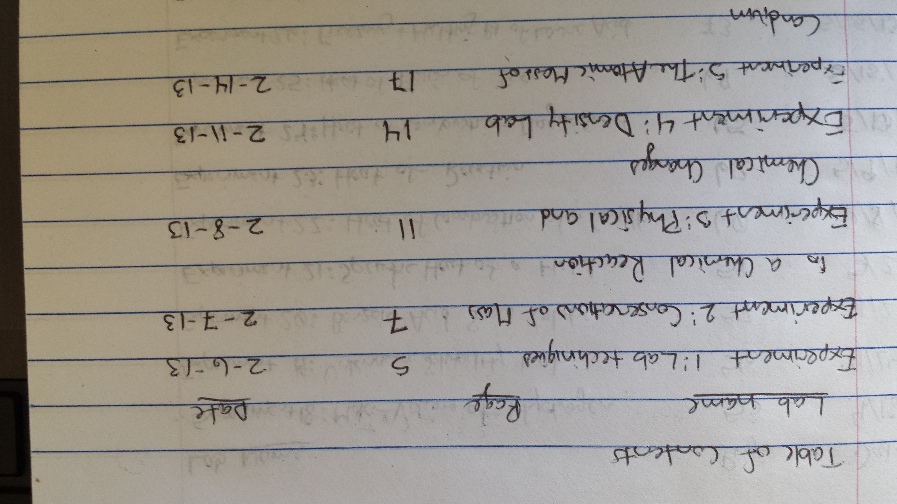
Example #2

Slide 13
Label up to page #10
Use the upper outer corner or the lower outer corner
Make sure it is uniform (always put it in the same place)

Slide 14
SKIP TO PAGE 5
Title “Lab Techniques”
You should always start a lab on the right hand side
Go back to the table of contents and write in the information for Lab 1, “Lab techniques”

Slide 15
Pre-Labs
Title
Purpose
Copy, or rephrase in your words
Prelab Questions
Rewrite question or phrase your answer so that question is obvious
Procedure
Rephrase & abbreviate (don’t copy verbatim!)
Data & Calculations
Make a table, chart, or designate an area to collect data and make calculations
Post Lab Questions
Same as prelab questions
Conclusion (only if applicable, completed after lab)

Slide 16
Scientific Notation
One non-zero digit to the left of the decimal
0.0098 mL = 9.8 x 10⁻³ mL
1.236 x 10³ meters = 1236 meters
602,000,000,000,000,000,000,000 atoms = 6.02 x 10²³ atoms
Know how to enter it into your calculator! (parenthesis are your friend)

Slide 17
Dimensional Analysis
Introduction

Slide 18
Dimensional Analysis
Used to convert from one unit to the next
You may already do something similar in your head
1 foot = ? inches
1 yard = ? feet
2,000 lbs = ? ton
1 dozen = ? eggs
? quarts = 1 gallon

Slide 19
Dimensional Analysis Helpful Conversions
1 inch = 2.54 cm
1 ft = 12 in
3 ft = 1 yard
5280 ft = 1 mile
4 quarts = 1 gallon
4 cups = 1 quart
16 tbsp = 1 cup
1 mile = 1.6 kilometers
1 Liter = 1.06 qt
1 Kg = 2.2 lbs
K H D B d c m

Slide 20
Significant Figures
Your new best friend

Slide 21
Significant Figures
What are they?
Numbers that can be counted as important
Why do we need them?
Auditorium example
Truck station example

Slide 22
Significant Figures
What are the rules?
Assume everything is significant except:
Zeros in the beginning
0.001 0.00987 0.1
0.0000000000000000000000000000007
2. Zeros in the end without a decimal point
1000 1000. 100.0 1.000 .1000 0.1000
Zeros not between two non zero numbers
305 5.8904 89,000,000,001
506,000 57050.00500300

Slide 23
Significant Figures
How do we remember them?
Zeros in the beginning never count!
Zeros in the end only count if there is a decimal point ANYWHERE!
Zero sandwiches are delicious (and count).

Slide 24
Chemical Reactions
Al + CuCl₂ → Cu + AlCl₃
Reactants → Products
(start) (end)

Slide 25
Recognizing Chemical Reactions
Possible Clues are:
Transfer of Energy
Endothermic – Heat is Absorbed (feels cold)
Exothermic – Heat is Released (feels hot)
Change in Color
Production of a Gas
Fizzing or Bubbling
Formation of a Precipitate
Solid that forms and settles out of a mixture

Slide 26
Accuracy and Precision
Book: page 64
Accuracy: close to ACCepted value
Precision: Repeating your results
A student determines the mass of a solid to be:
12.36 grams
11.57 grams
11.06 grams
The metal weighs 11.59 grams.
These are accurate
A student determines the mass of a solid to be:
15.57 grams
15.58 grams
15.59 grams
The metal weighs 11.59 grams
These are precise

Slide 27
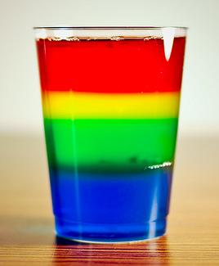
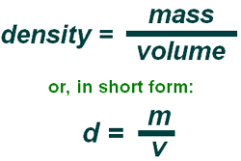
Density
Definition:
The ratio of the mass of an object to its volume:
Book: page 90-91 # 46-48
*Be able to solve for all of the variables

Slide 28
Conservation of Mass
Mass is conserved in a Chemical Reaction.
Reactants → Products
Mass of Reactants = Mass of Products
grams (g) Reactants = grams (g) Products
A + B → C
5.00 g + 7.00 g = ? g

